Slide 1
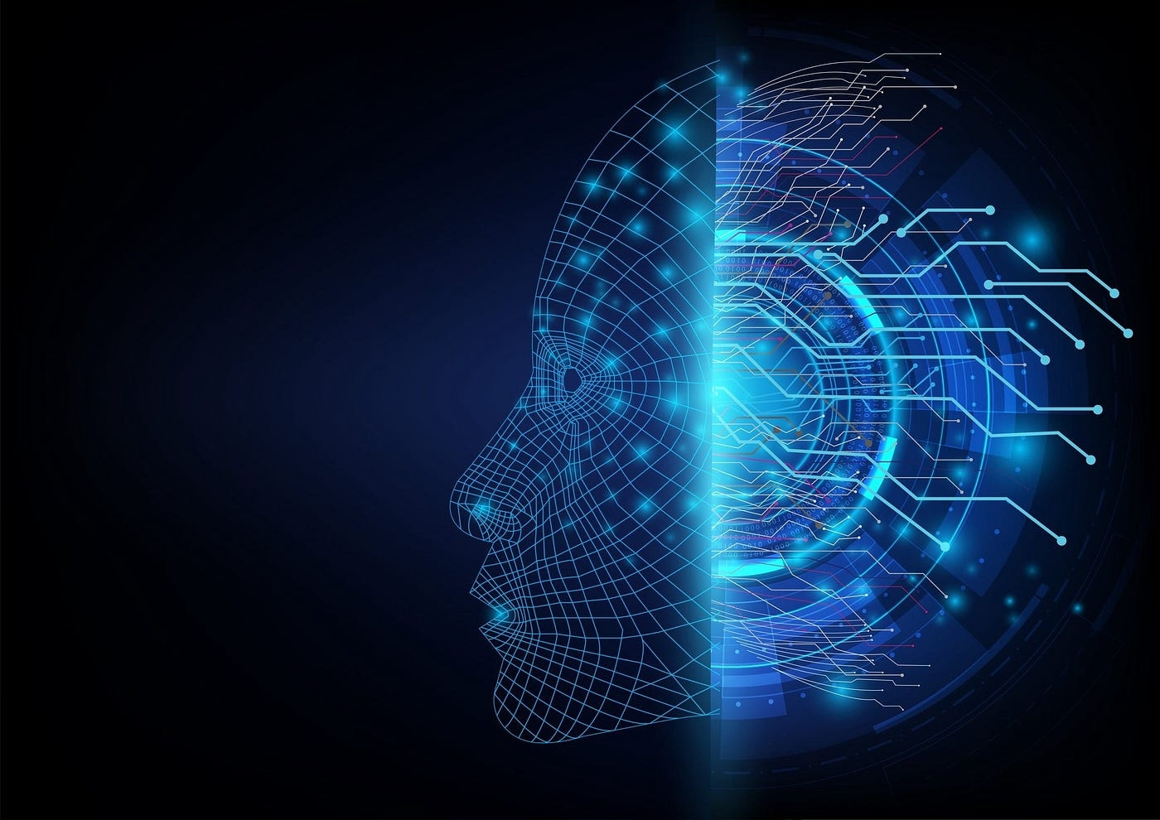
Large Language Models

Slide 2
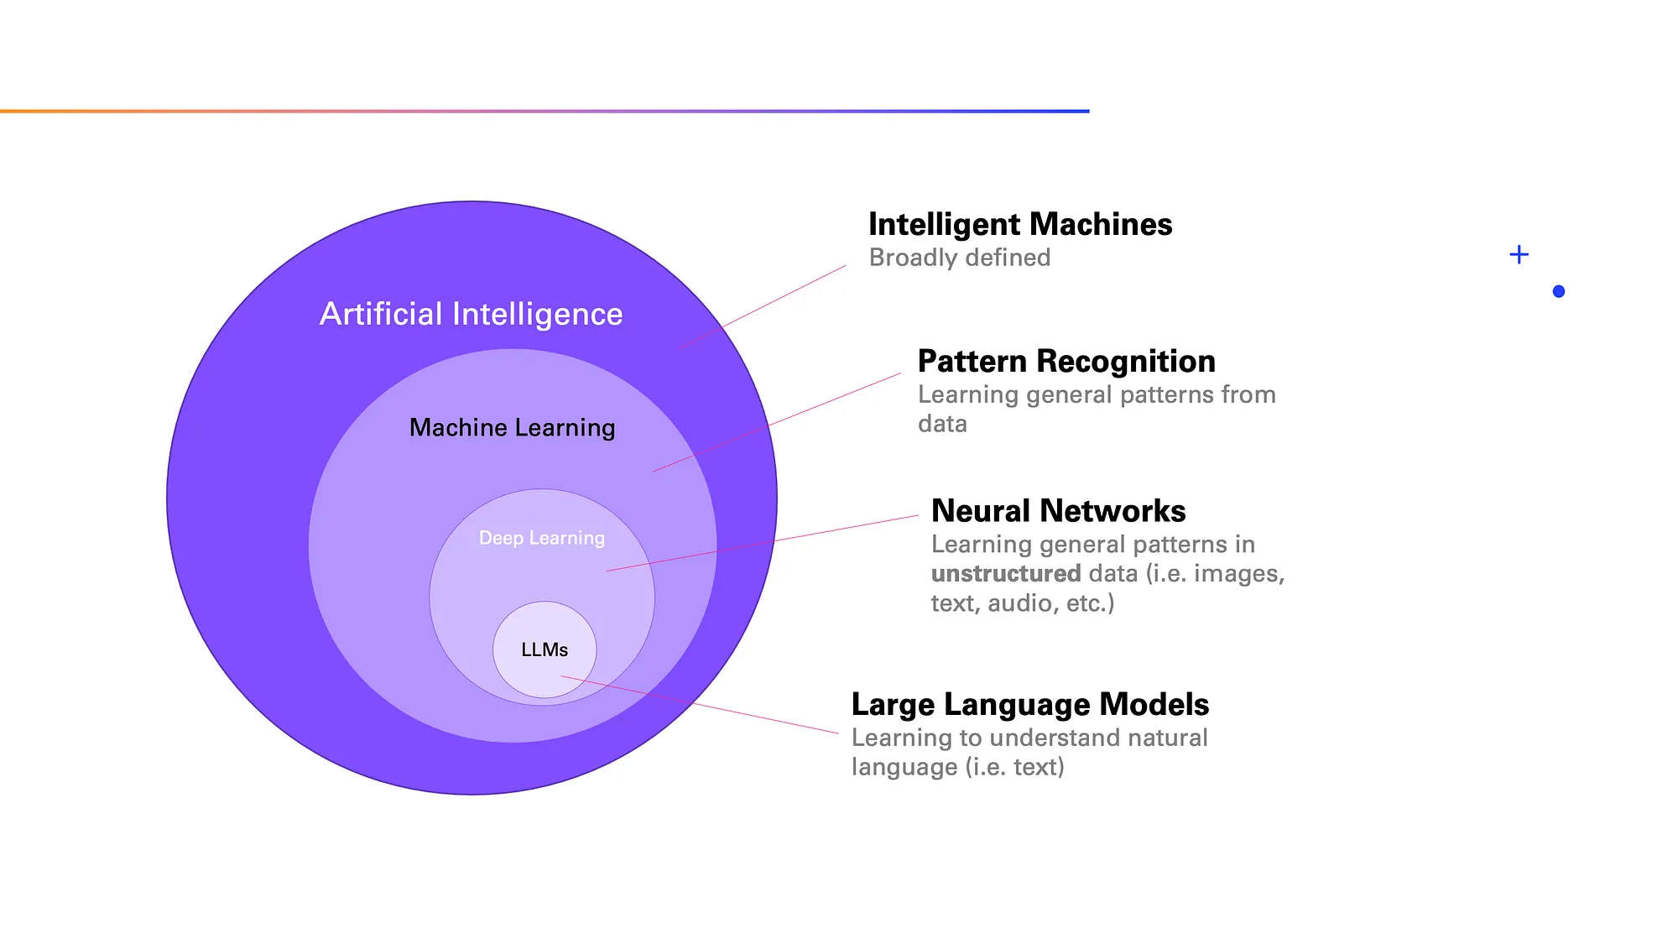

Slide 3
Introduction:
The ability of Generative AI models to “converse” with humans and predict the next word or sentence is due to something known as the Large Language Model, or LLM.
It is to be noted that while not all generative AI tools are built on LLMs, all LLMs are forms of Generative AI which in itself is a broad and ever-expanding category or type of AI.
In order to grasp the science behind ChatGPT’s efficiency, it is crucial to understand what an LLM is.

Slide 4
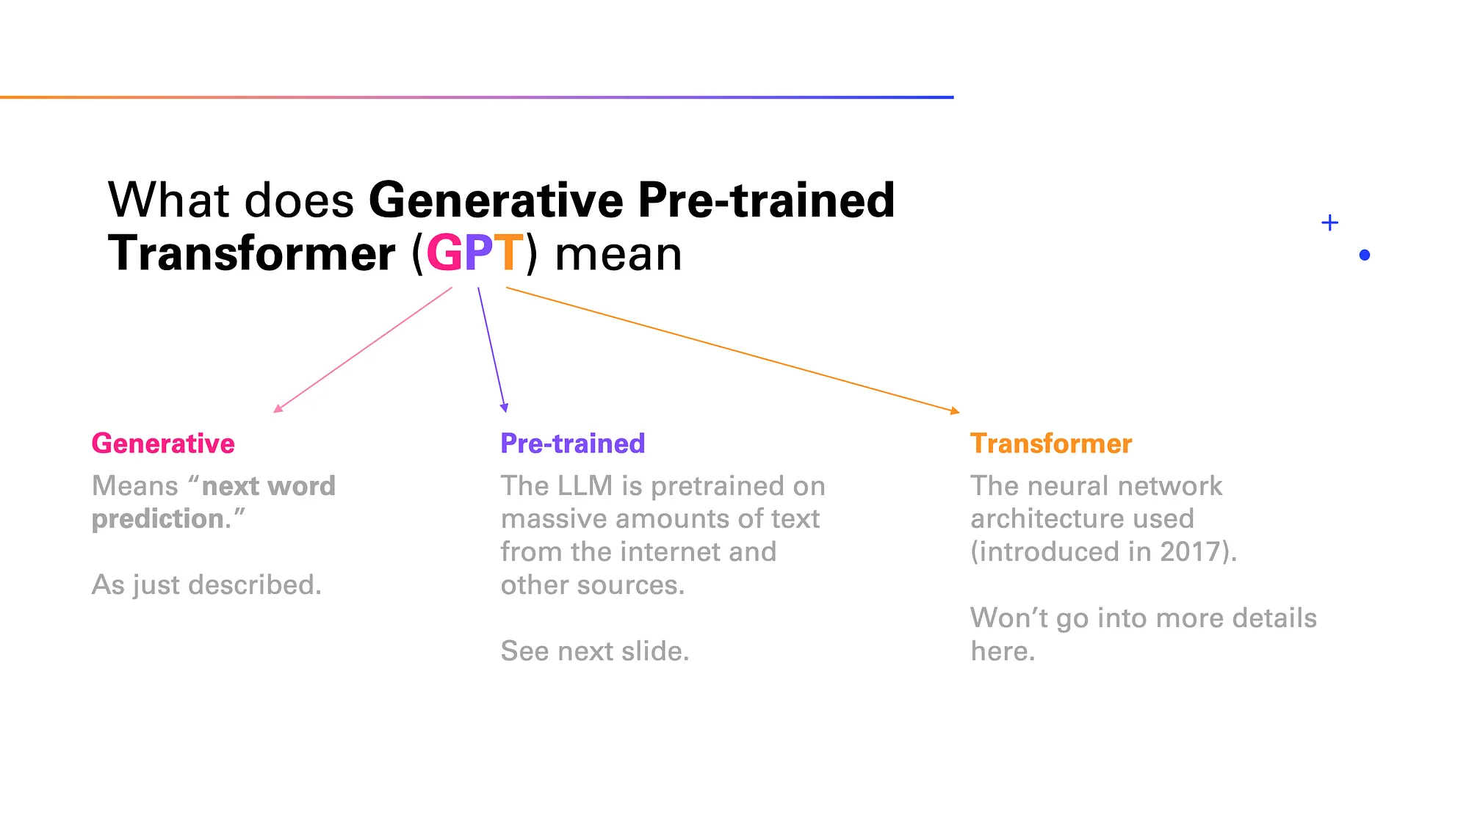

Slide 5
What is an LLM?
According to Google, LLMs are large general-purpose language models that can be pre-trained and then fine-tuned for specific purposes. In simple words, these models are trained to solve common language problems such as text classification, question answering, text generation across industries, document summarisation, etc.
the ‘Large’ indicates two meanings — the enormous size of training data; and the parameter count. In Machine Learning, parameters, also known as hyperparameters, are essentially the memories and knowledge that a machine learned during its model training.

Slide 6
How many types of LLMs are there?
On the basis of architecture, there are three types — autoregressive, transformer-based, and encoder-decoder.
GPT-3 is an example of an autoregressive model as they predict the next word in a sequence based on previous words.
LaMDA or Gemini (formerly Bard) are transformer-based as they use a specific type of neural network architecture for language processing.
The encoder-decoder models that encode input text into a representation and then decode it into another language or format.

Slide 7
How many types of LLMs are there?
Based on training data, there are three types of LLMs — pretrained and finetuned, multilingual or models that can understand and generate text in multiple languages, and domain-specific or models that are trained on data related to specific domains such as legal, finance or healthcare.
LLMs can also vary based on their size as large models usually require more computational resources. However, they offer better performance.
They can also be categorized as opensource and closed-source based on availability as some are freely available while some are proprietary. LLaMA2, BlOOM, Google BERT, Falcon 180B, OPT175 B are some open-source LLMs, while Claude 2, Bard, GPT-4, are some proprietary LLMs.

Slide 8
What can LLMs do?
LLMs are utilized for text classification, distinguishing and categorizing text into various predefined categories.
They excel in text generation, producing human-like text based on provided prompts or contexts.
LLMs are adept at text summarization, condensing large blocks of text into concise summaries while retaining key information.
They power conversational AI systems such as chatbots and question-answering models, enabling engaging interactions with users.
LLMs contribute to speech recognition and identification, transcribing spoken language into written text and identifying speakers.
They serve as spelling correctors, identifying and rectifying spelling errors in written text to improve accuracy and readability.

Slide 9
What are the advantages of LLMs?
A single model can be used for a wide variety of tasks.
LLMs can reportedly perform well even with limited amounts of domain or industry specific data.
LLMs can leverage the knowledge they learned from general language training data.
Another important aspect is their ability to continuously improve their performance. As more data and parameters are infused into LLMs, their performance improves.

Slide 10
Implementation:
Model: 'gpt-3.5-turbo’ (Pre-trained LLM-Text Generation)
Model: ‘dall-e-2’(Pre-trained LLM-Image Generation )
Agent: “Langchain” (We can access different LLM’s)
We got an authorization for using the above model from “OpenAI API key”
Tasks:
Text Summarization & Language Translation (English-Telugu)
Question Answering (I provided custom data, the 2024 Budget Speech in PDF format, to the model and asked questions. It answers based on its knowledge.)
Real-time information retrieval using "SerpAPI key" I asked questions related to the 2024 elections in Russia, WPL 2024, etc.
Creation of an interactive chatbot using the "Gradio" interface.
Text to Image Generation using “dall-e-2” large language model.

Slide 11
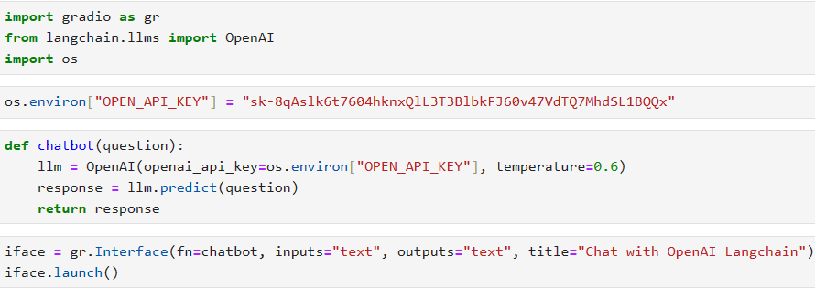
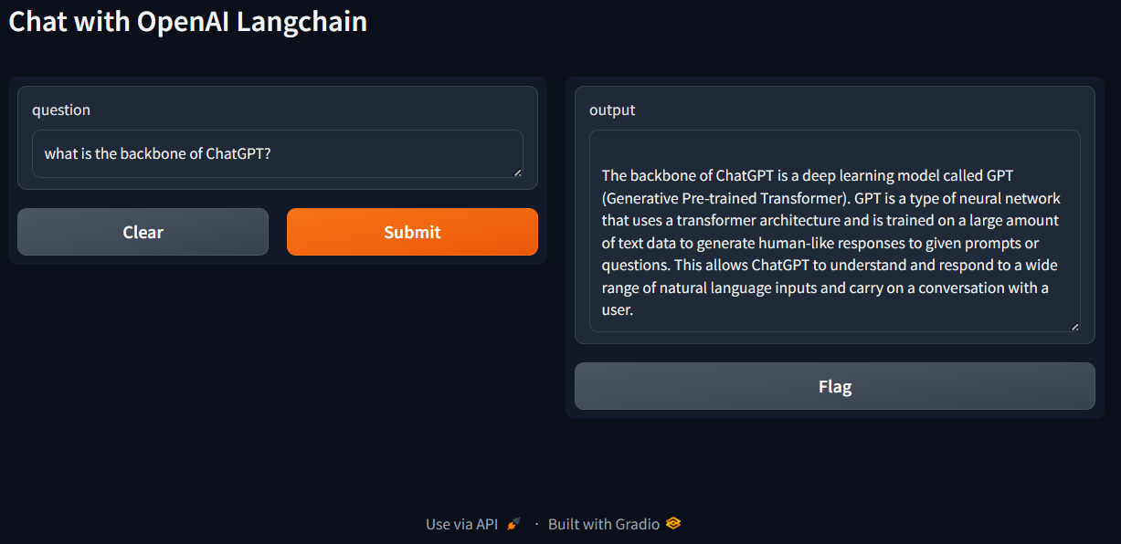
Creation of interactive Chatbot using “gradio” interface:

Slide 12
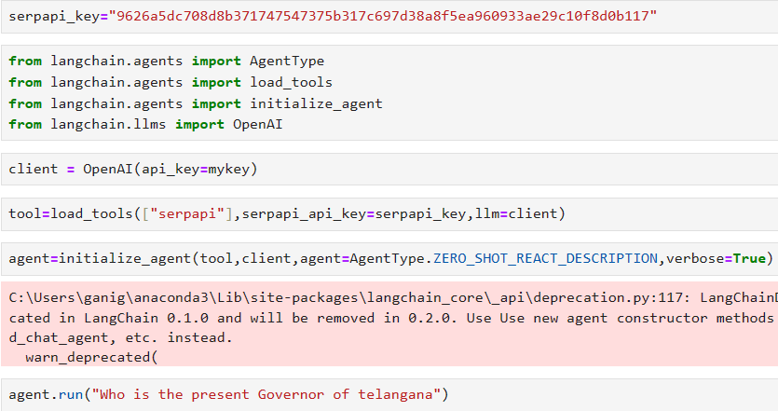
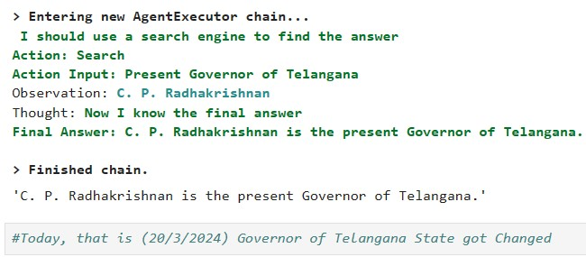
Real-time information retrieval using “SerpAPI key”

Slide 13
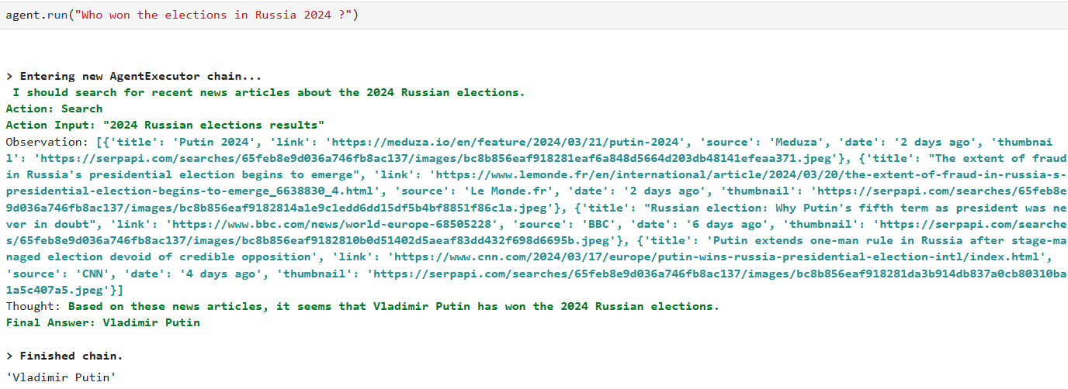

Slide 14
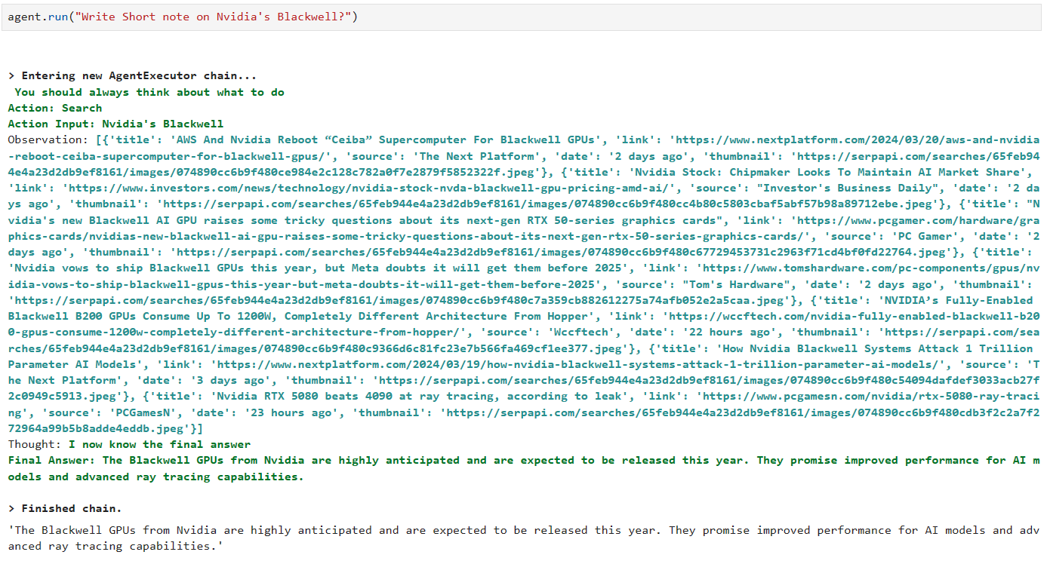

Slide 15
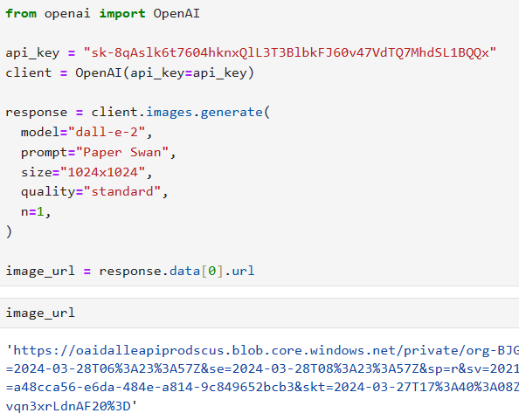

Text to Image Generation:

Slide 16
Thank You

